Slide 1
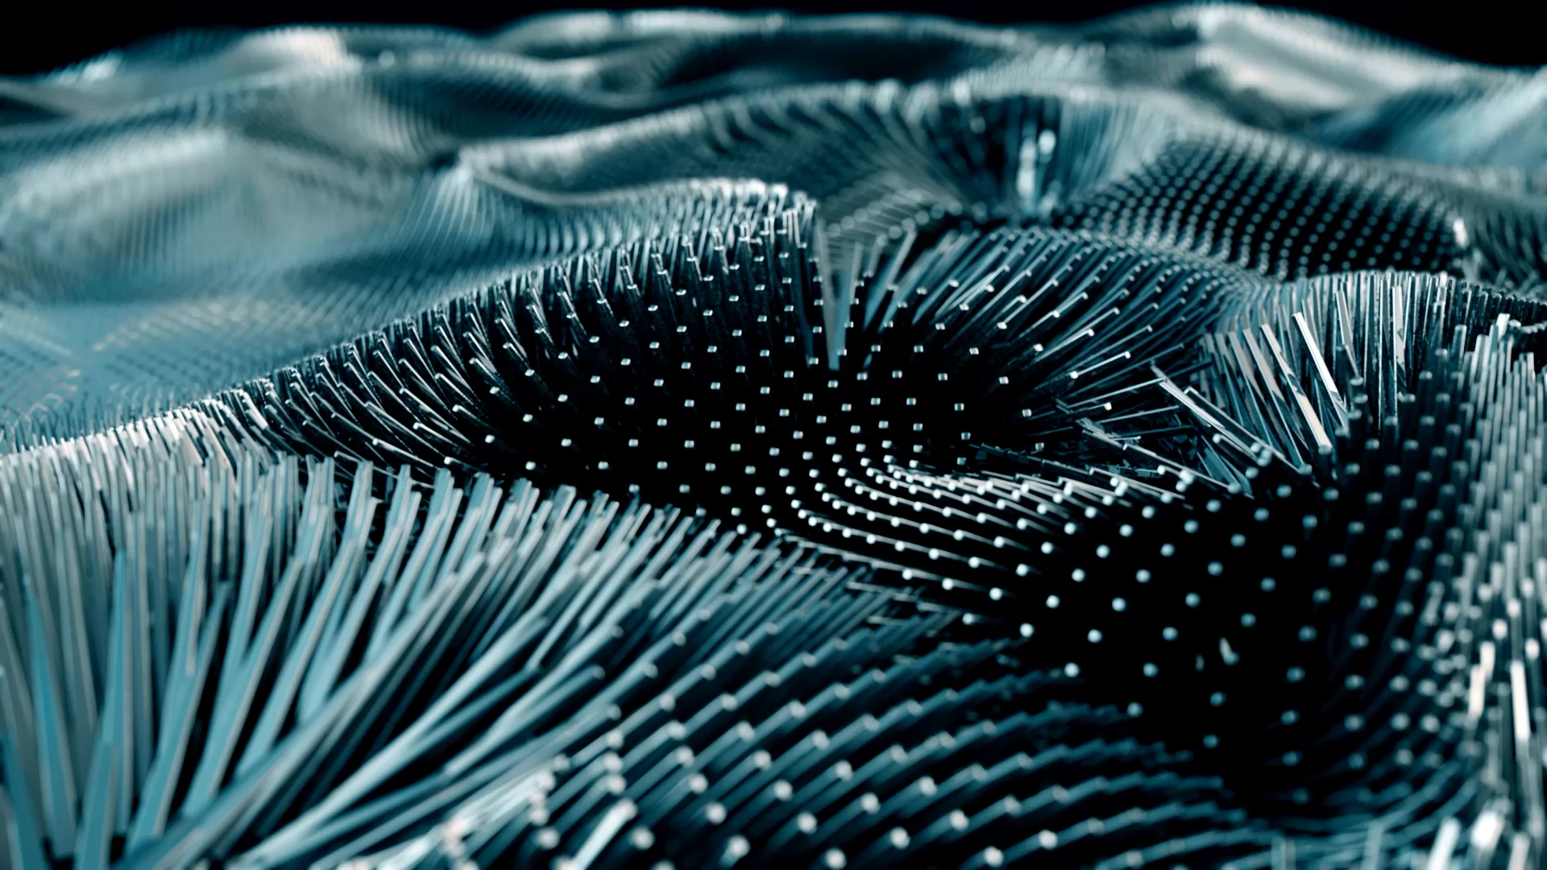

Slide 2
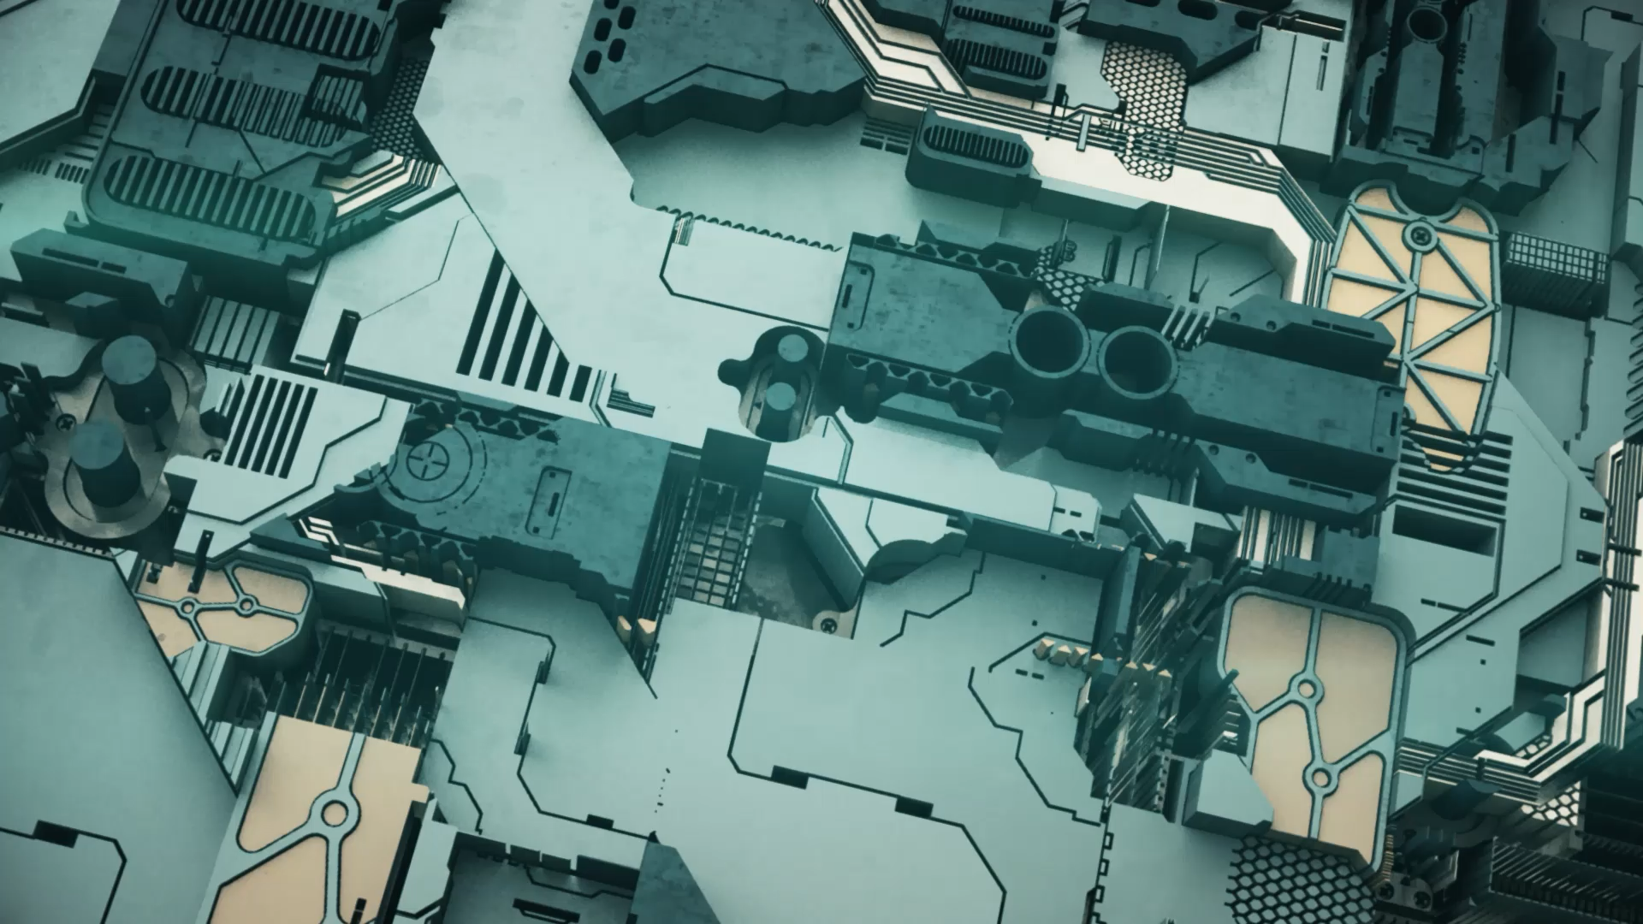



COMPUTER COMPONENTS

Slide 3
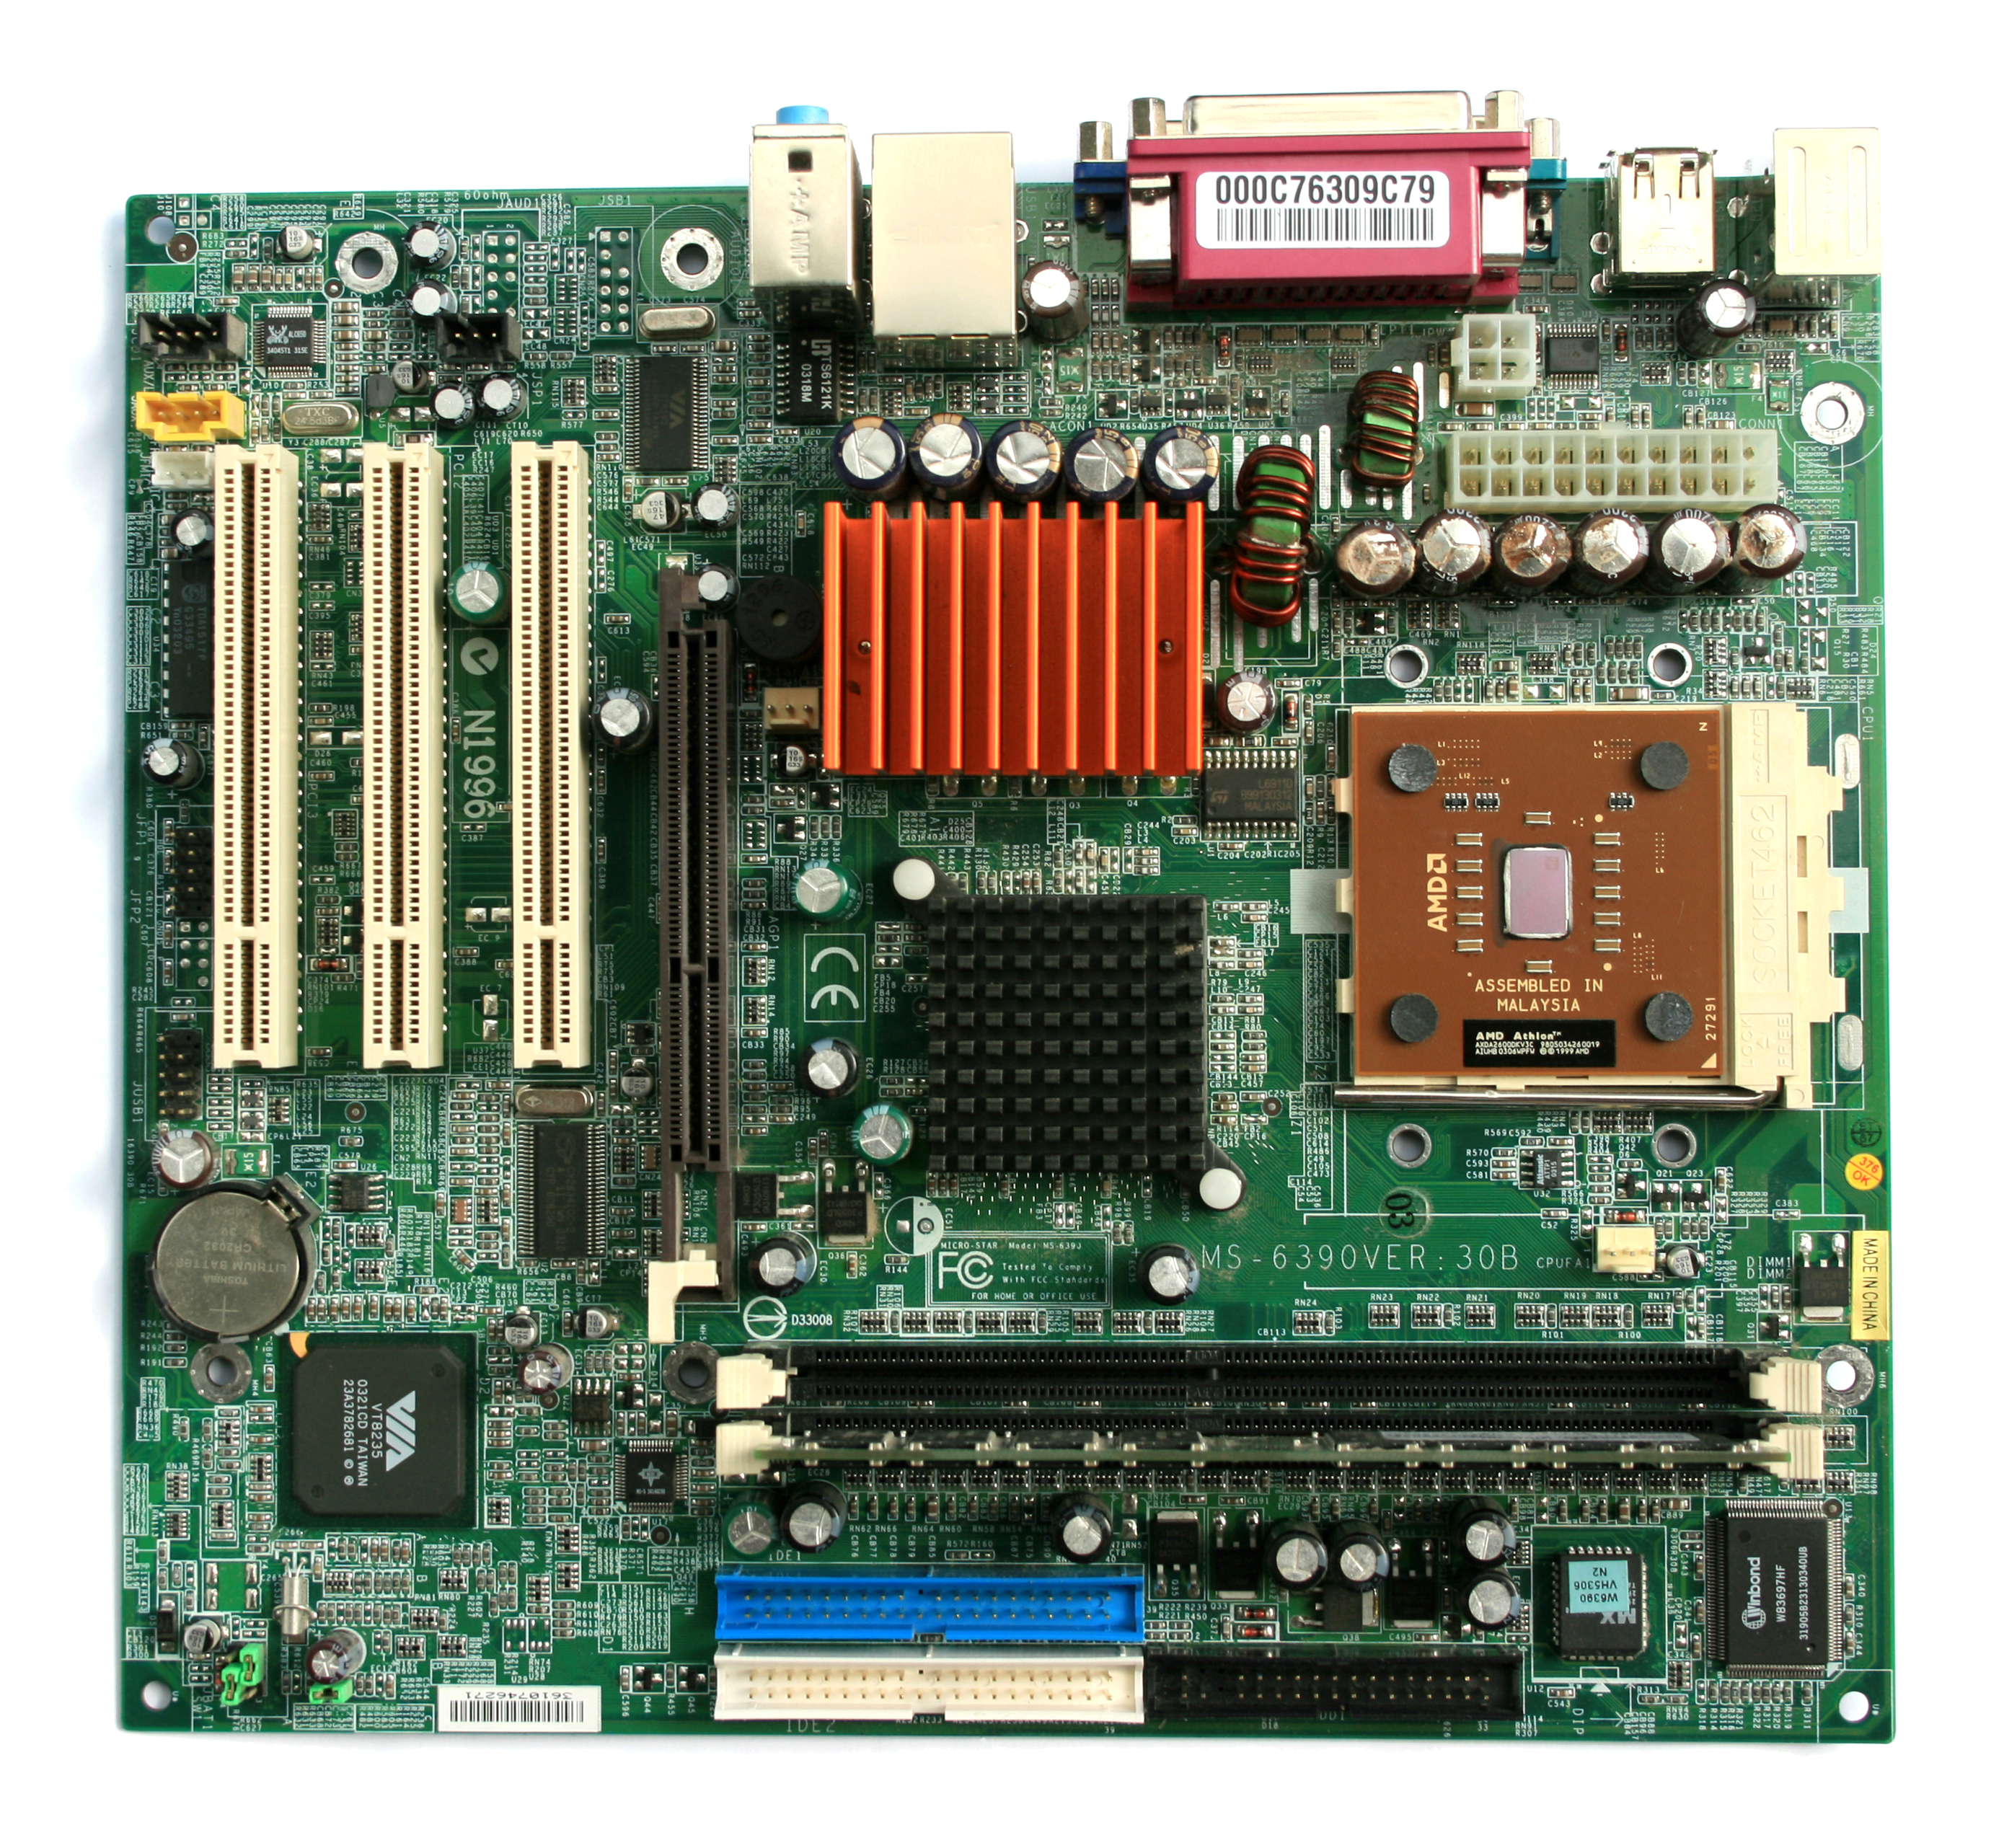
MOTHERBOARD
The main printed circuit board of a computer
Where all components of the computer connect, making it the communication point
Fun fact! There are software/firmware components to a motherboard. On a PC this is known as a BIOS/UEFI
This Photo by Unknown Author is licensed under CC BY-SA
Notes:
motherboard

Slide 4
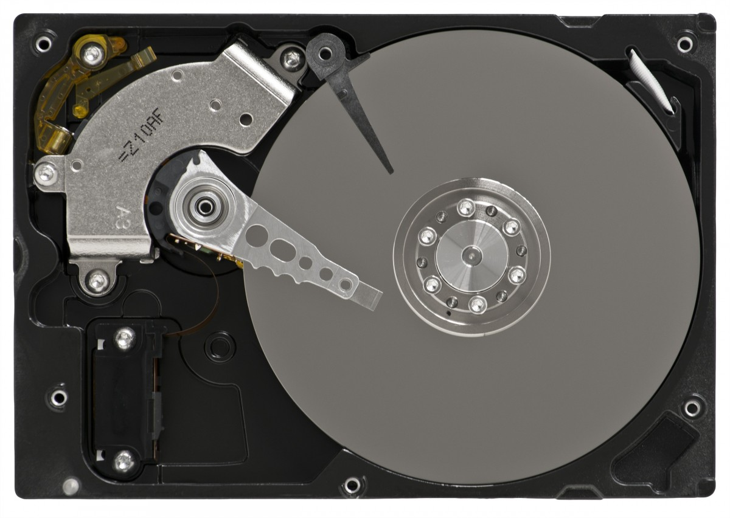
HARD DRIVE
A magnetic recording layer on a disk, known as a platter, with an arm that moves across the platter
Where all data is stored
Fun Fact! The hard drive platter spins from 44 hundred to 72 hundred times per minute
Notes:
Hard drive

Slide 5
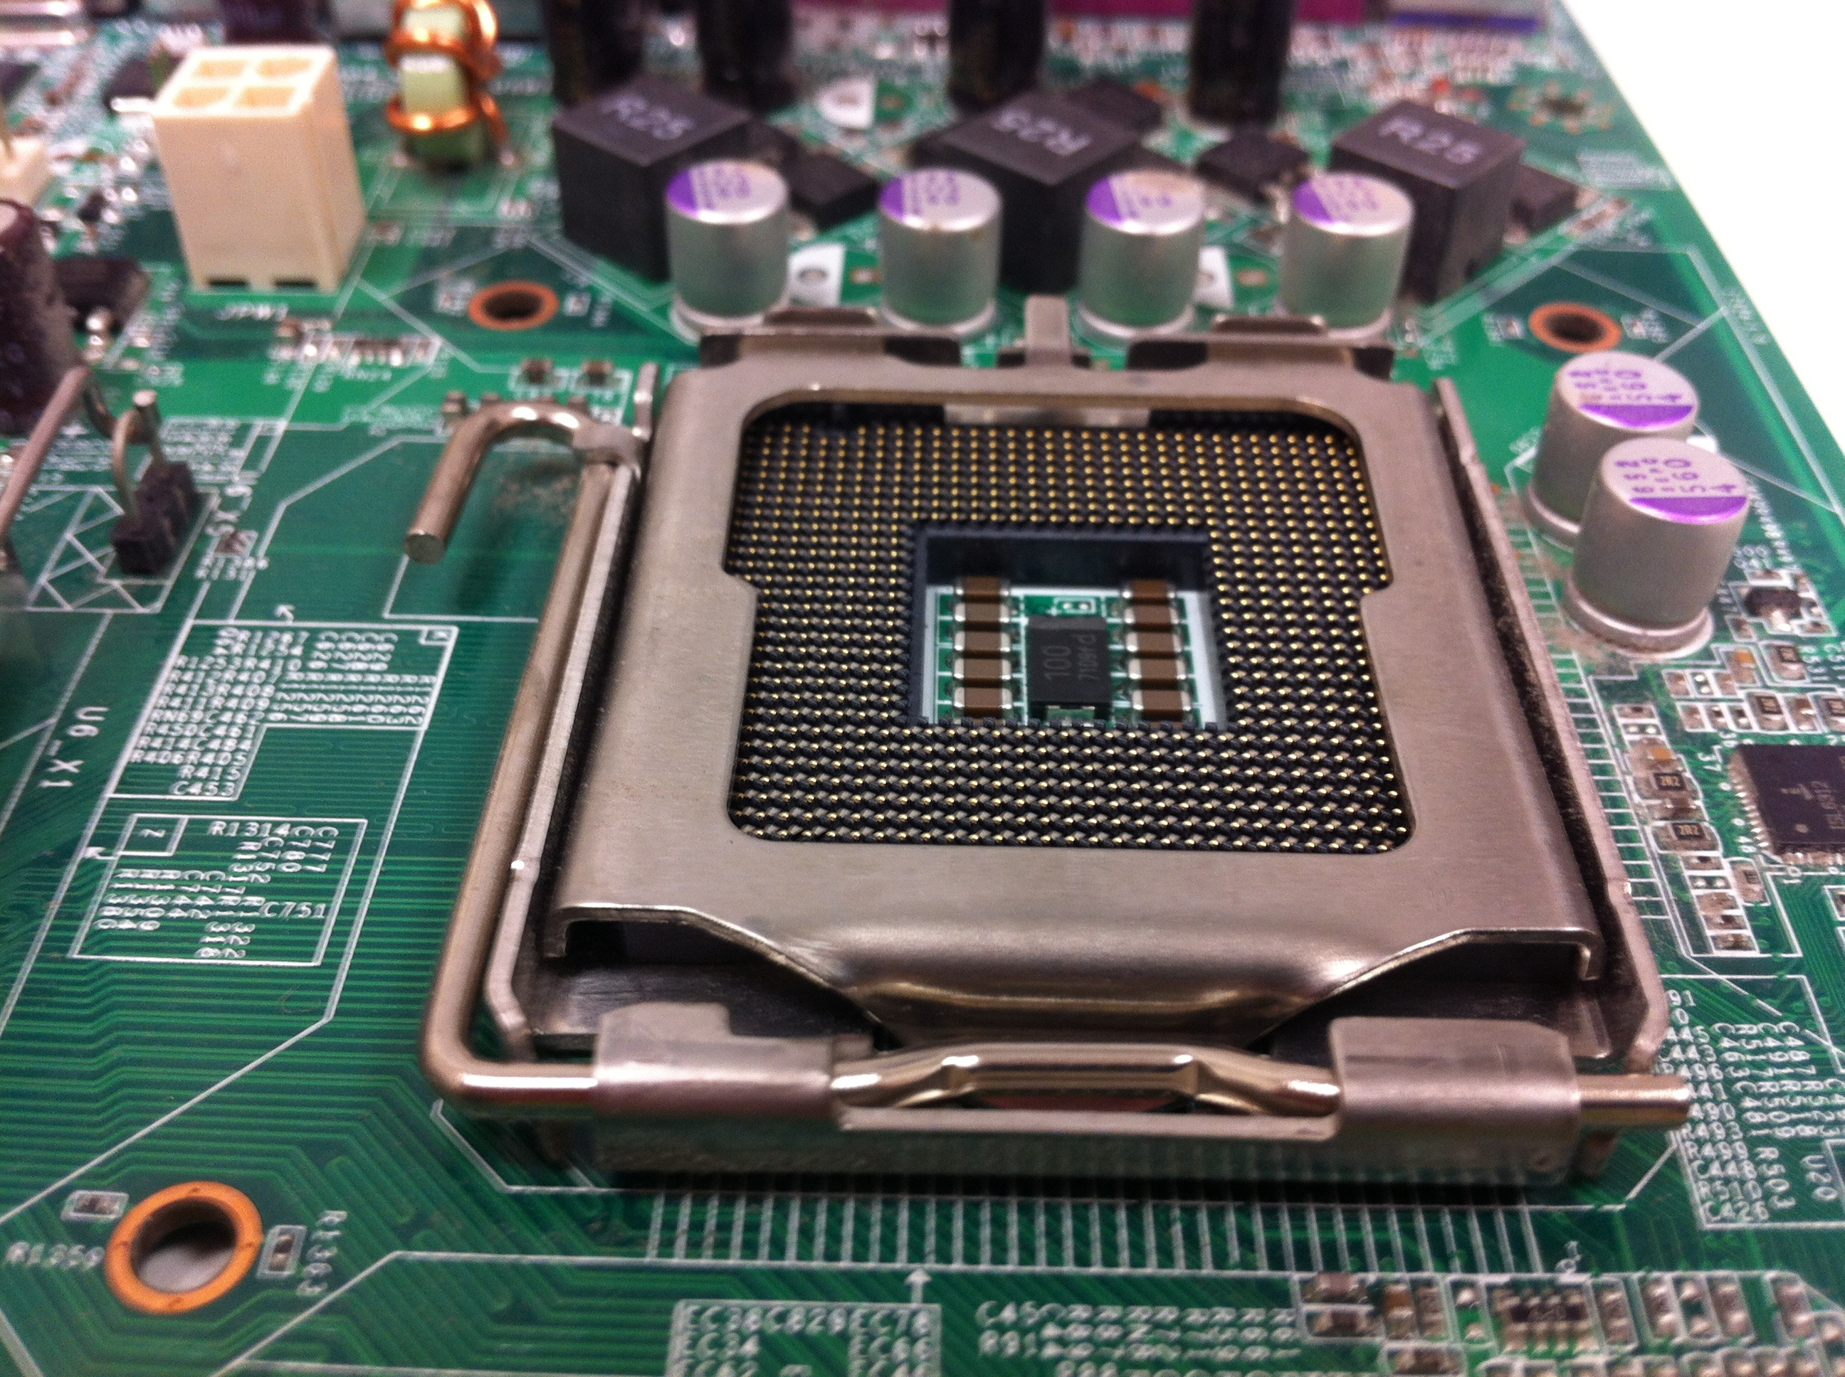
CENTRAL PROCESSING UNIT
A silicone-based microprocessor
Performs most of the processing and control functions of a computer
Fun Fact! This microprocessor is mounted to a PCB with heat sinks
Notes:
Central Processing Unit

Slide 6




HISTORICAL EVENTS

Slide 7
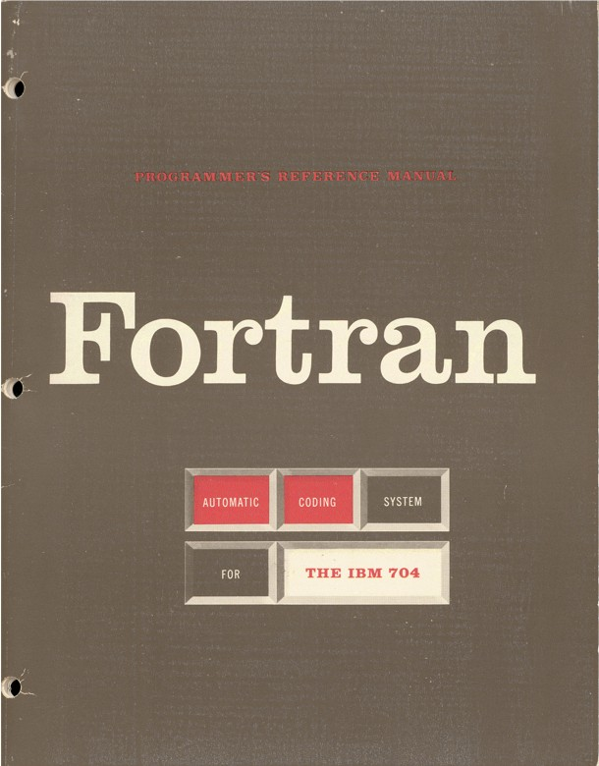
FORTRAN
Invented in 1957
The first programming language to use English
Previous programming languages were unintelligible numbers, but this advancement made programming more discernable
Fun fact! The full name for Fortran is FORmula TRANslating system
This Photo by Unknown Author is licensed under CC BY-SA

Slide 8
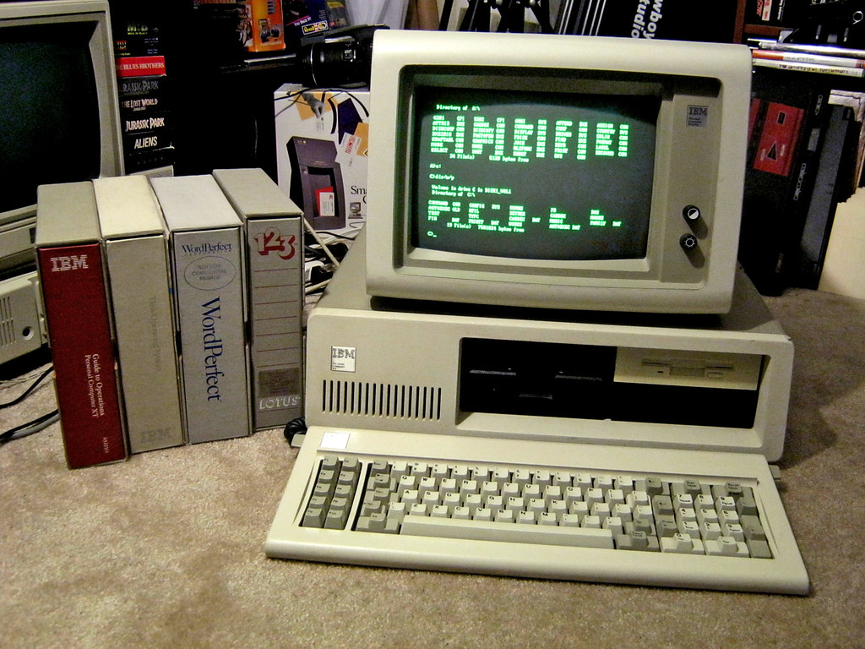
IBM PC
Released on August 12/1981
The ICM PC was created under the work of Don Estridge
It was a catalyst in making computers mainstream
Fun fact! This popularized the term PC as personal computers

Slide 9
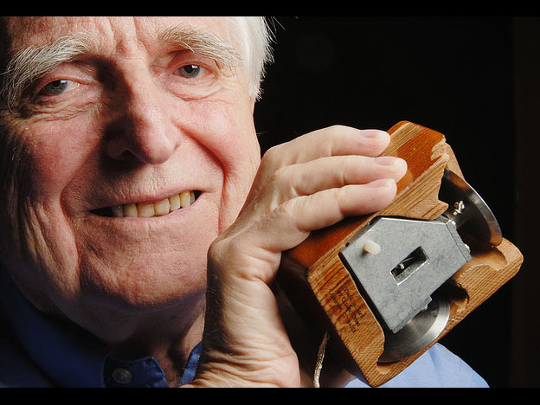
DOUGLAS ENGELBART
Invented the first computer mouse in the early 1960’s
This made interactive computing more accessible and effective
Douglas gained a small grant from NASA to explore solutions for moving a curser, which turned into the invention of the mouse
Fun fact! The ball of the mouse was inspired by a planimeter
This Photo by Unknown Author is licensed under CC BY-SA-NC
Notes:
This Photo by Unknown Author is licensed under CC BY-SA-NC

Slide 10
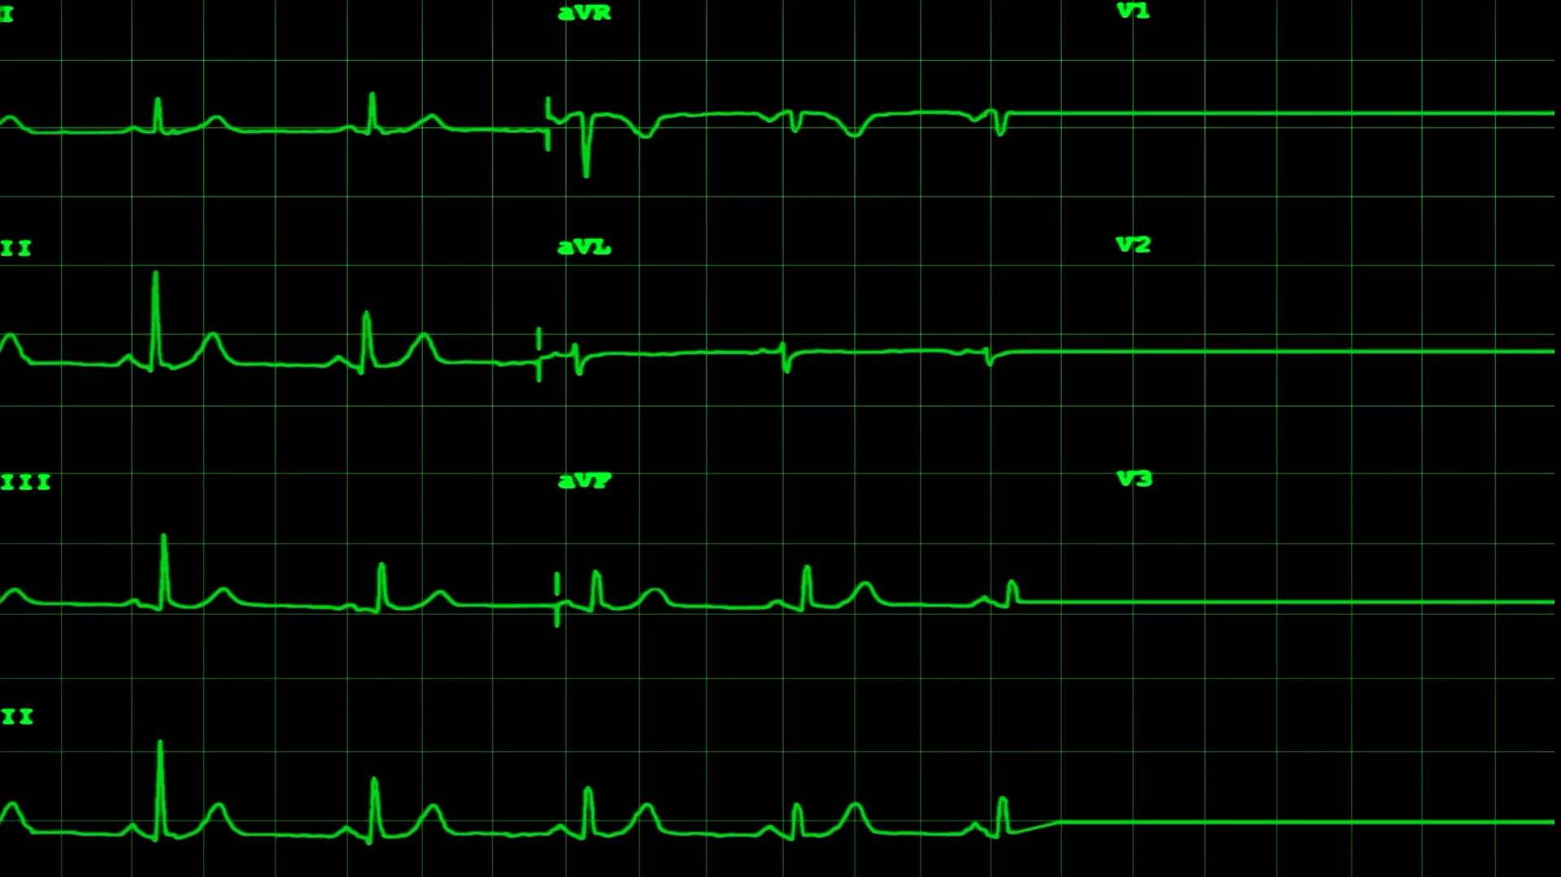



CATASTROPHIES
Notes:
Mars climate – ILOVEYOU – therac 25

Slide 11

MARS CLIMATE ORBITER
A space probe that was launched on December 11/1998 with plans on furthering research and information about Mars
On September 23/1999 it was lost and suspected to have been obliterated due to getting too close to Mars
The code used in imperial measurements instead of metric, causing incompatible code
Further communication on units would have prevented error
Fun fact! The mars climate orbiter cost $327 million to make
Notes:
This Photo by Unknown Author is licensed under CC BY-SA

Slide 12
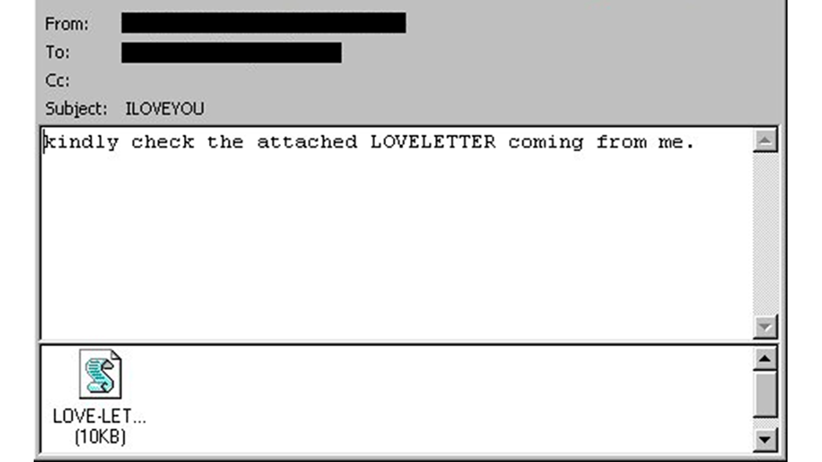
ILOVEYOU
Millions of people across the globe received an e-mail on May 5, 2000, which was titled ILOVEYOU
There was a file attached labelled as a love letter, which many people opened, causing a malware and the letter being sent to everyone in the recipient's address file
It caused about $8 billion in damages and cost $15 billion to remove from computers
Public education on email viruses could have prevented millions from opening the file inside
Fun(or not so fun)fact! 50 million infections were reported in 10 days
Notes:
This Photo by Unknown Author is licensed under CC BY-NC-ND

Slide 13
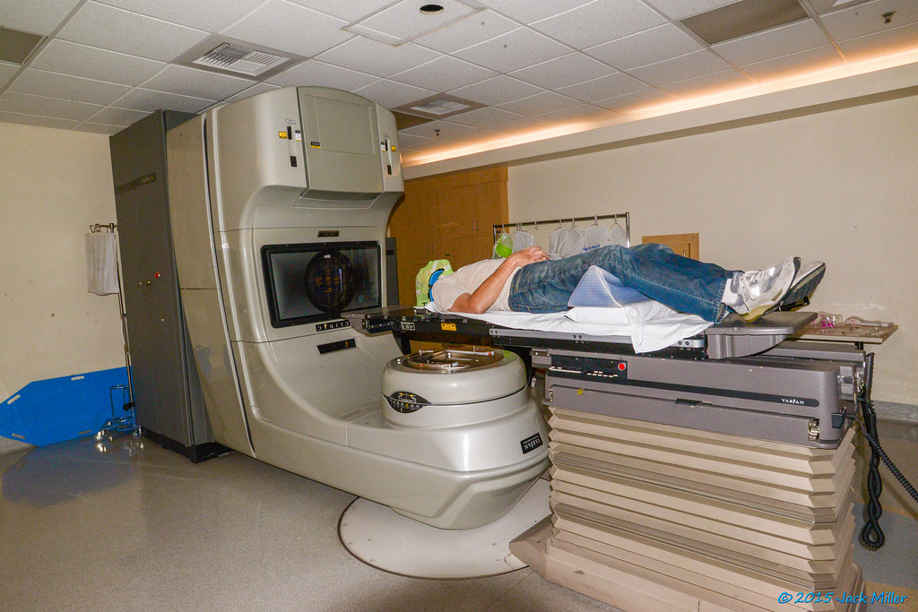
THERAC-25
A machine for radiation therapy made by Atomic Energy of Canada Ltd
There were 2 modes, mega volt x-ray and direct electron beam, but there was a flaw where a mega volt was released even though electron beam was chosen
This led to 6 deaths
Further testing before release and promptly stopping use when misfired could have prevented this
Fun(or not so fun)fact! This happened in 1985
Notes:
This Photo by Unknown Author is licensed under CC BY-SA

Slide 14
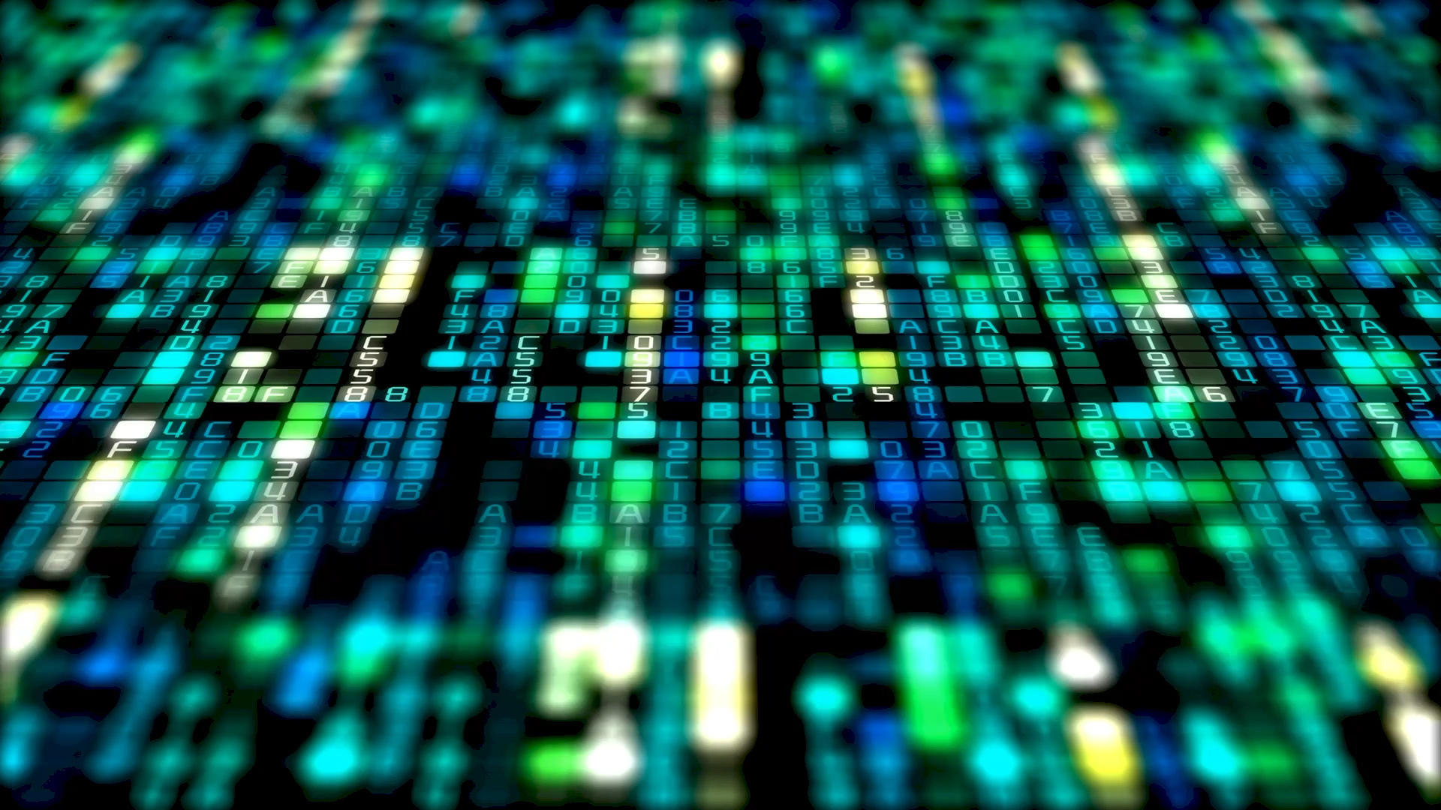



CAREERS
Notes:
Cloud engineer - Computer and information research Scientists – applications architect

Slide 15

CLOUD ENGINEER
Have a focus on all things cloud, including maintenance, support and building systems within the cloud
Very common for companies to hire cloud engineers to run cloud computing for this business
Average salary of $106,460
Notes:
This Photo by Unknown Author is licensed under CC BY-SA-NC

Slide 16

COMPUTER & INFORMATION RESEARCH SCIENTIST
Taking existing technologies and developing systems within them
Creating new systems, infrastructures and databases through their research
Average salary of $111,185
Notes:
This Photo by Unknown Author is licensed under CC BY-NC-ND

Slide 17

APPLICATIONS ARCHITECT
In charge of making new application
Additionally, editing already existing applications and troubleshooting applications
Average salary of $113,757
This Photo by Unknown Author is licensed under CC BY-SA-NC
Notes:
This Photo by Unknown Author is licensed under CC BY-SA-NC

Slide 18

PROGRAMMING LANGAUGES
A set of instructions and syntax that is used to create software program
Python, C++ and JavaScript are examples of prominent programming languages
Each language has tasks they can be best suited for due to their strengths and weaknesses

Slide 19
https://1.bp.blogspot.com/-ZqYQiRQ69sQ/UdWAqT-zq_I/AAAAAAAAJ8w/5zqIsZM-AsE/s624/douglas_engelbart.jpg
https://upload.wikimedia.org/wikipedia/commons/thumb/1/19/Mars_Climate_Orbiter_2.jpg/1200px-Mars_Climate_Orbiter_2.jpg
https://images.wired.it/wp-content/uploads/2020/05/04180728/Loveletter-wurm.png
https://live.staticflickr.com/7779/17418264742_b8d5d83fe8_b.jpg
https://www.thedigitaltransformationpeople.com/wp-content/uploads/2018/04/cloud-computing-machine-learning.jpeg
https://researchoutreach.org/wp-content/uploads/2019/05/shutterstock_1104131792.jpg
https://tekhdecoded.com/wp-content/uploads/2020/03/word-image-19-1024x684.jpeg
IMAGE REFERENCES
https://upload.wikimedia.org/wikipedia/commons/d/dd/MicroATX_Motherboard_with_AMD_Athlon_Processor_2_Digon3.jpg
https://c.pxhere.com/photos/24/fa/hard_drive_overhead-1387072.jpg!d
https://get.pxhere.com/photo/computer-technology-gadget-electronics-motherboard-microcontroller-electronic-device-computer-hardware-personal-computer-hardware-display-device-cpu-socket-741008.jpg
https://upload.wikimedia.org/wikipedia/commons/0/07/Fortran_acs_cover.jpeg
https://live.staticflickr.com/7089/13322878365_0d196dcbeb_b.jpg

Slide 20
TEXT REFERENCES
https://www.youtube.com/watch?v=HRi1BHjID3o
https://dougengelbart.org/content/view/162/
https://www.youtube.com/watch?v=AGI371ht1N8
https://listverse.com/2019/07/30/top-10-most-catastrophic-computer-failures-in-history/
https://www.youtube.com/watch?v=1RpJ2Pcdggw
https://www.logicraysacademy.com/blog/things-every-programmer-should-know/
https://www.geeksforgeeks.org/introduction-to-programming-languages/
https://www.youtube.com/watch?v=ExxFxD4OSZ0
https://www.youtube.com/watch?v=nQIB5qcl3R8
https://www.youtube.com/watch?v=dZcszUj5szA
https://www.youtube.com/watch?v=zIYkol851dU
https://www.youtube.com/watch?v=1kypaBjJ-pg
https://www.youtube.com/watch?v=pBiVyEfZVUU

